Slide 1


Alpha wrapping with AN offset
Cédric Portaneri, Mael ROUXEL-LABBé, Michael Hemmer, David Cohen-Steiner, pierre Alliez
Notes:
Todo:

Slide 2
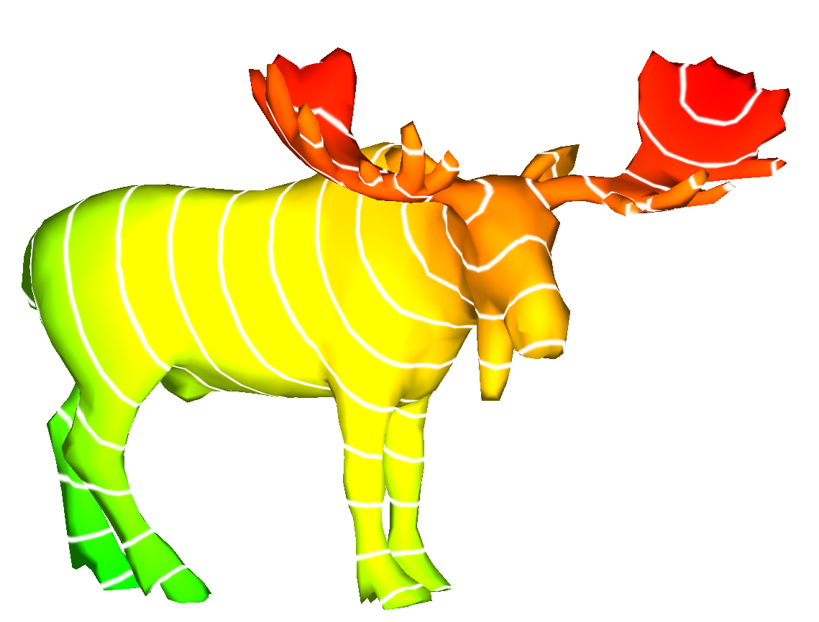
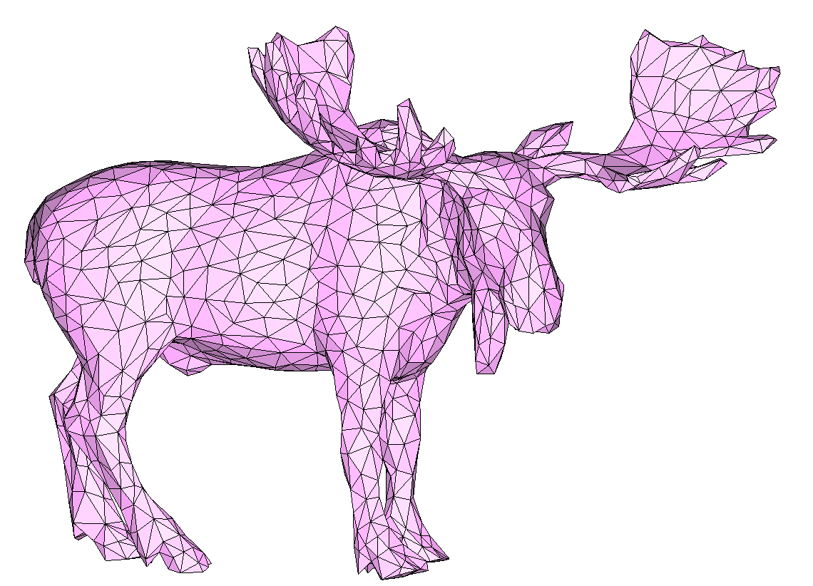
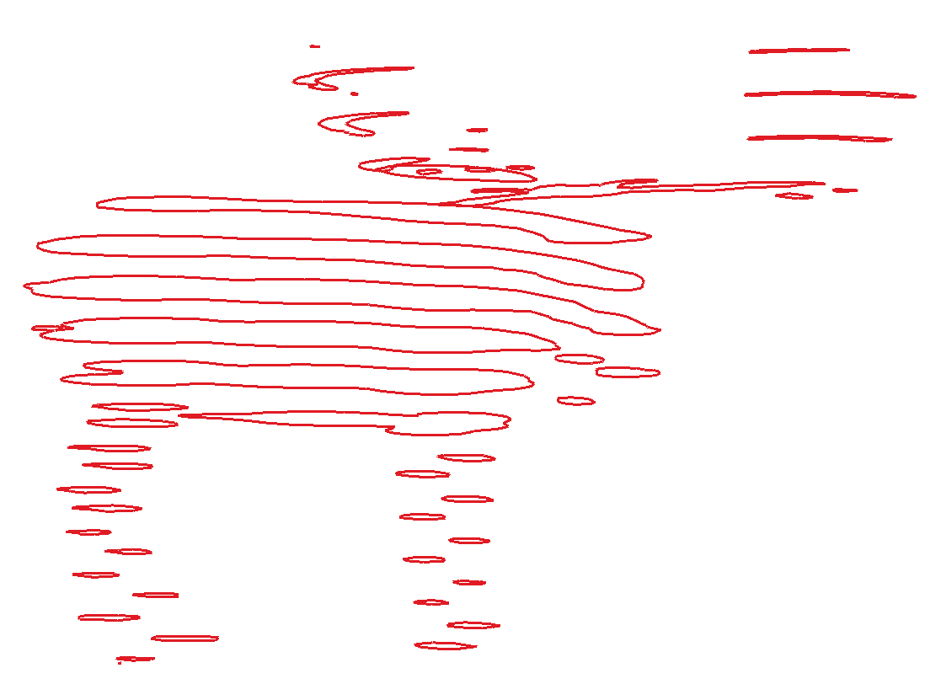
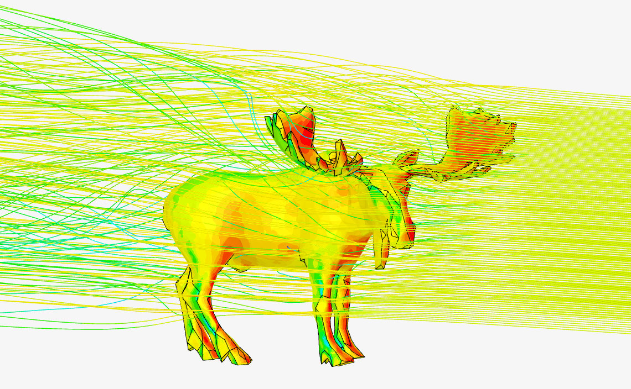
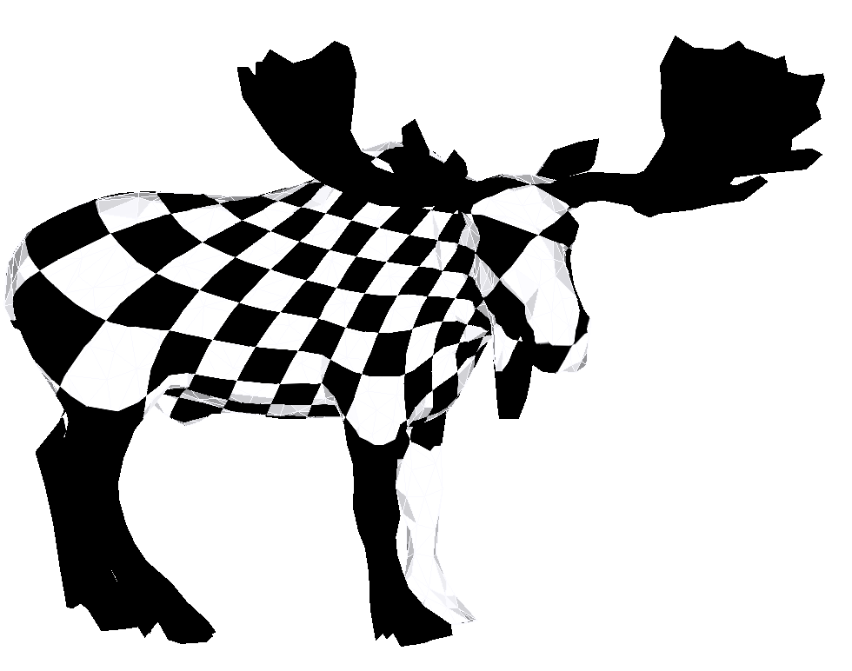
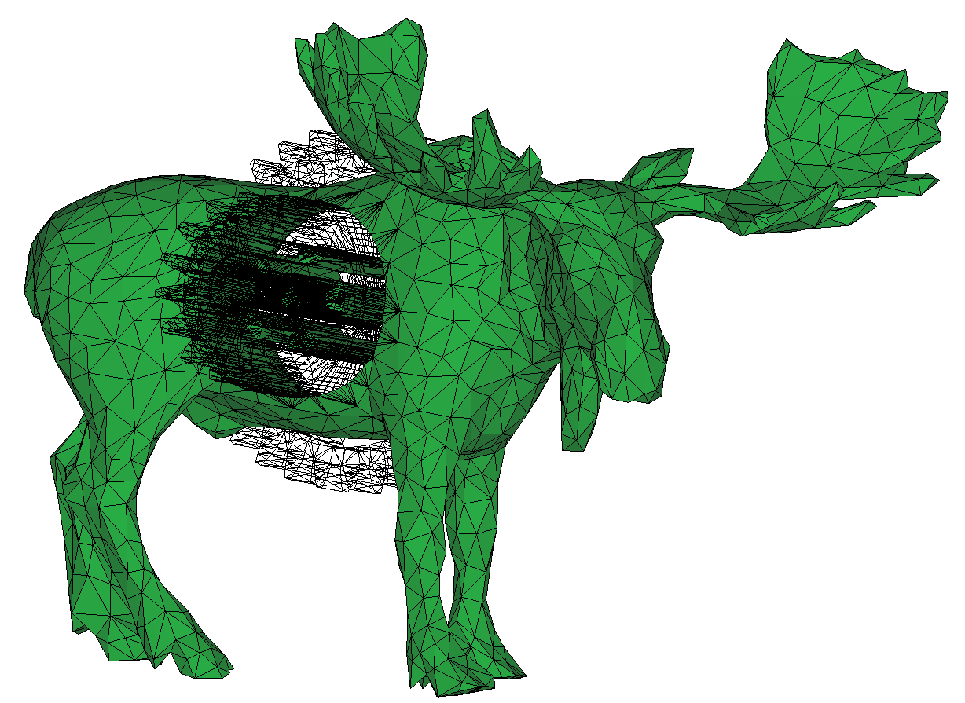
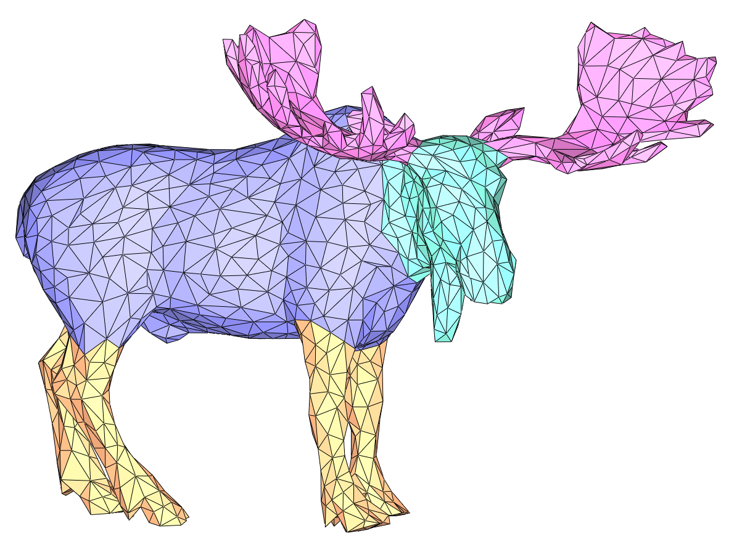
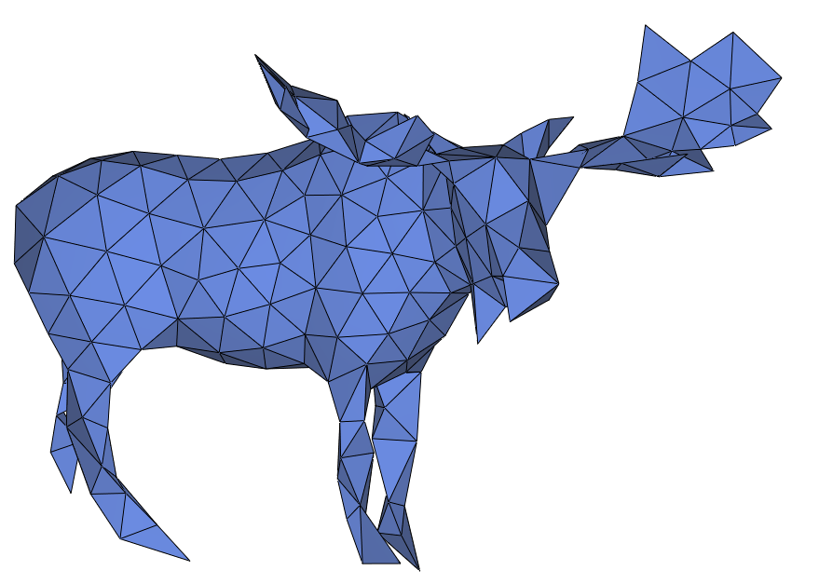
Motivation: Mesh validity
What is mesh validity?
A mesh is valid if it is:
2-manifold combinatorially and geometrically
Without self-intersections
Mesh validity is crucial to many applications in geometry processing and computer graphics
Computing distances
Slicing
Moose [Jérémie Louvetz]
Parameterization
Simulations
Parameterization
Segmentation
Boolean Operations
Remeshing & Simplification
Notes:
Voice: Surface meshes are essential components in many geometry processing and computer graphics application. Most applications require, or at least prefer, input meshes that are combinatorially 2-manifold, watertight, and orientable.

Slide 3
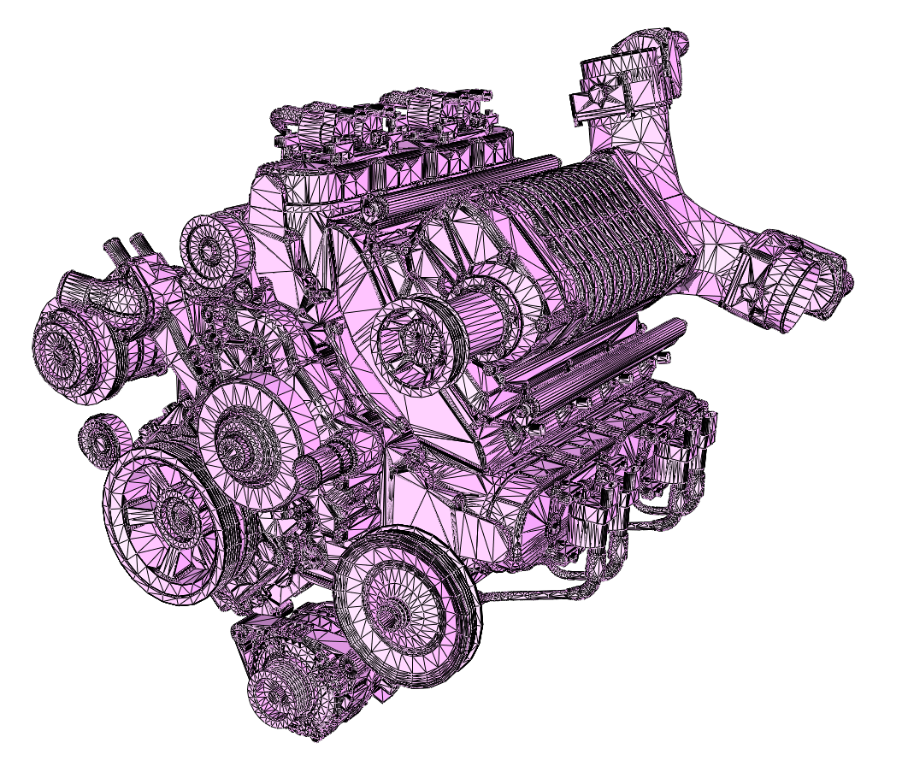
Motivation: mesh validity
Many meshes are not valid
Chevy Engine [GrabCAD]
Notes:
Voice: Unfortunately, many mesh generation methods are imperfect and oftentimes produce meshes such as this engine mesh with many issues

Slide 4
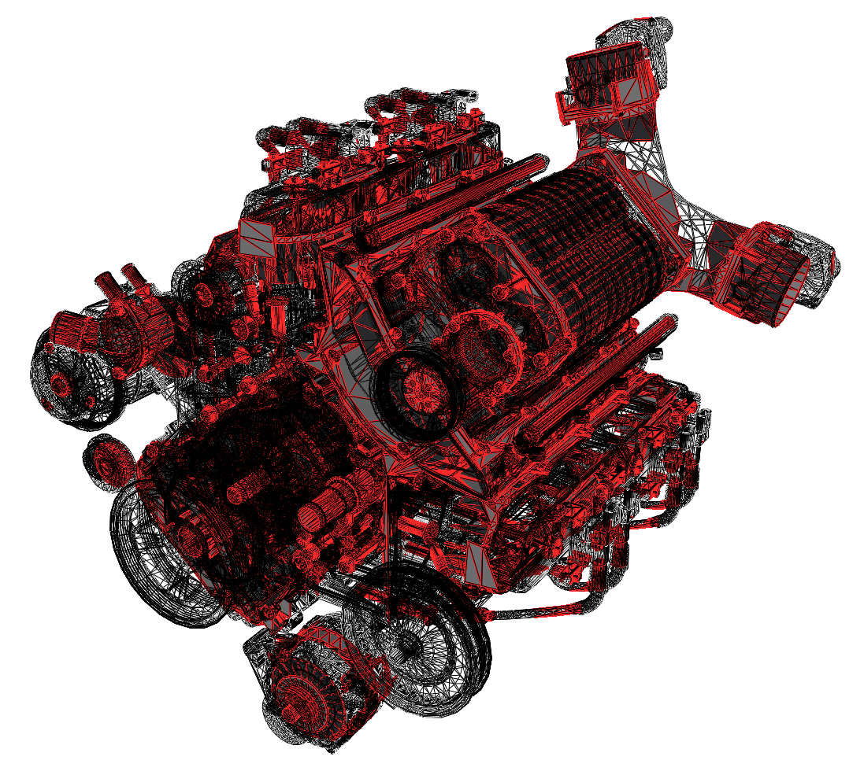
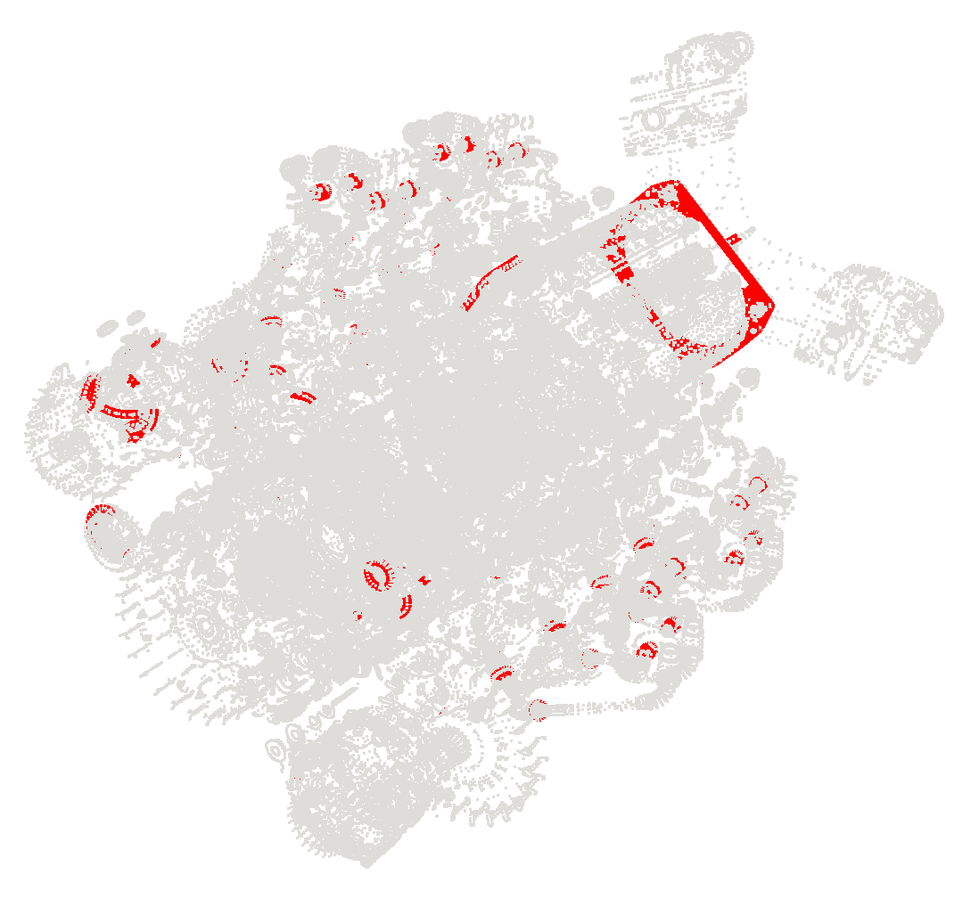
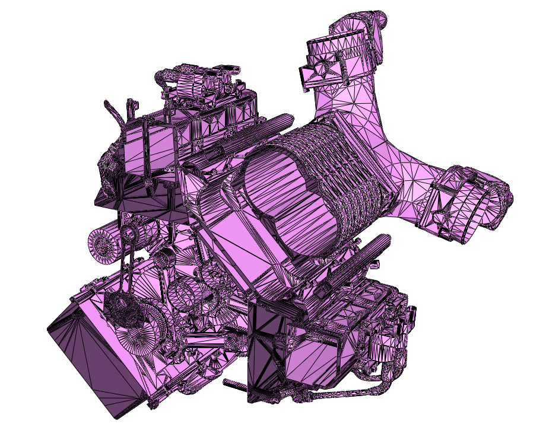
Motivation: mesh validity
Many meshes are not valid
Self-intersections
Non-manifoldness & spurious boundaries
Complex inner structures
Notes:
Voice (cont.): Unfortunately, many mesh generation methods are imperfect and oftentimes produce meshes such as this engine mesh with many issues

Slide 5
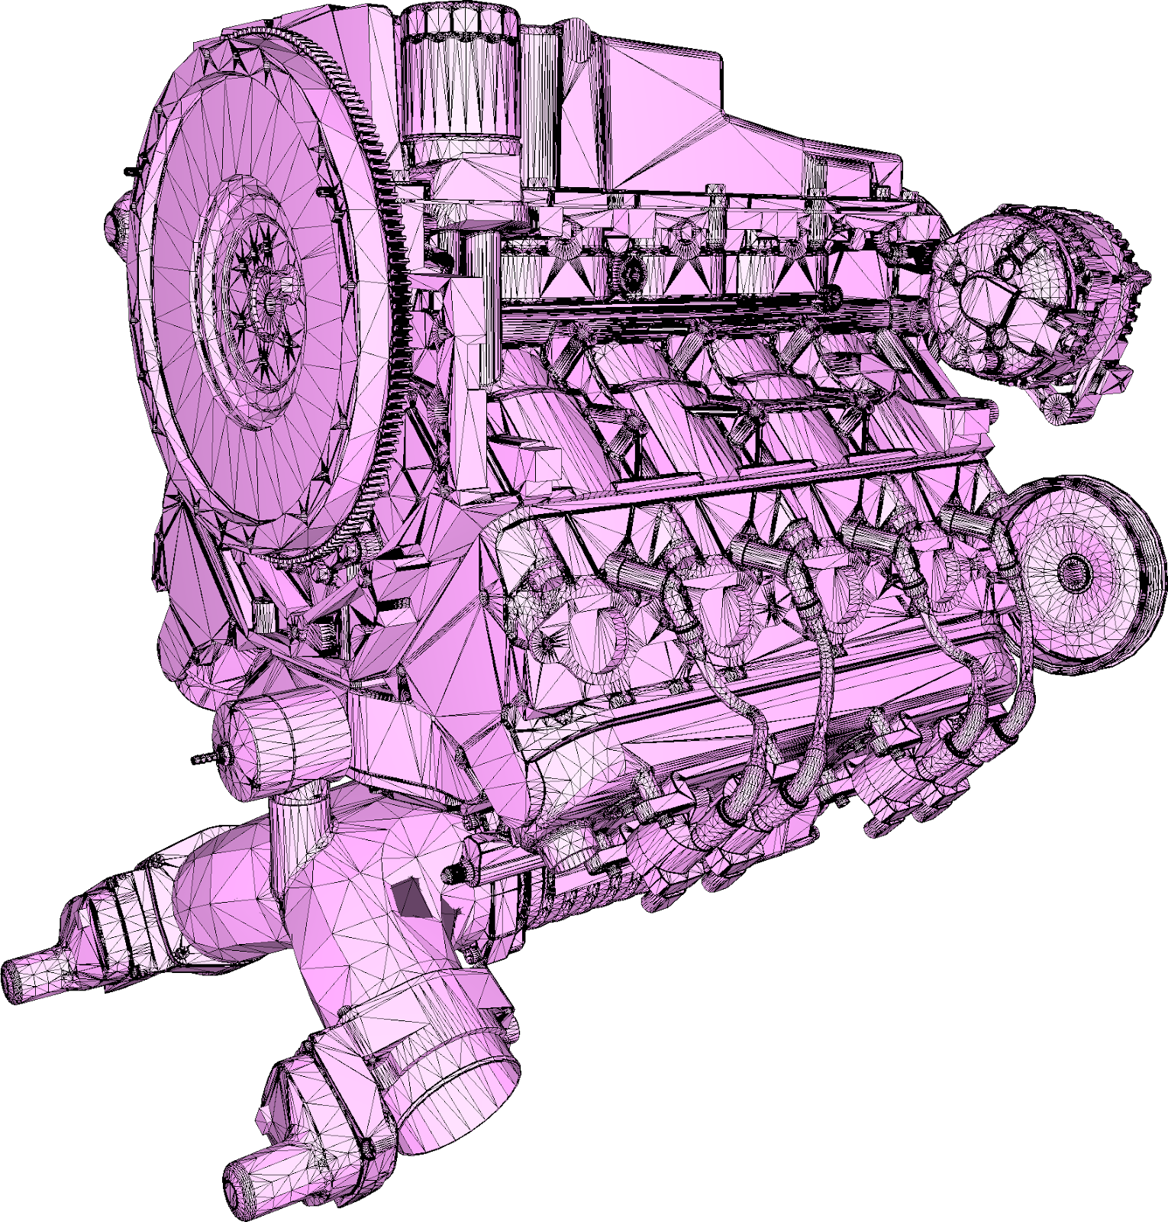
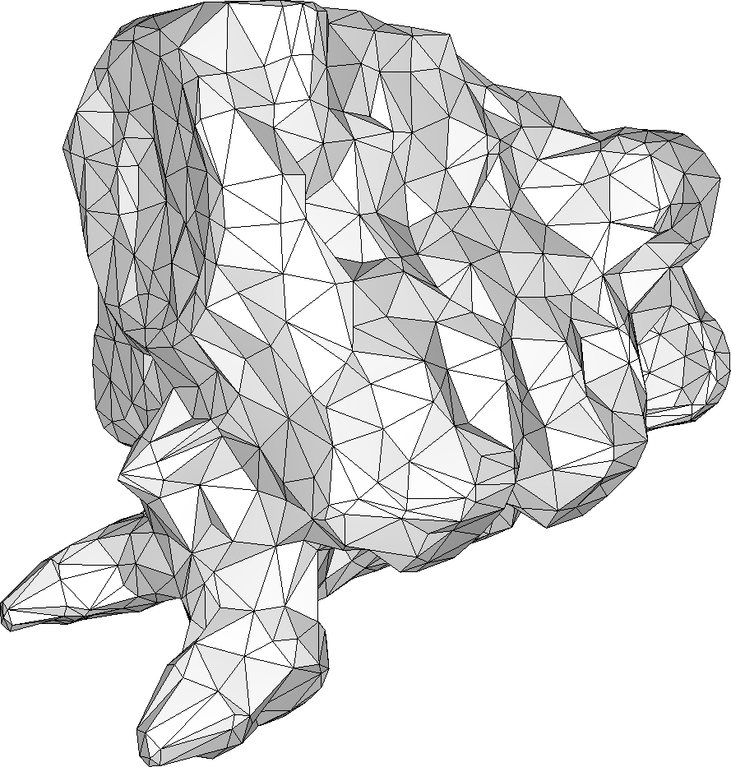
Problem statement
Input
3D model, possibly with defects
DESIRED Output
Watertight, manifold triangle mesh
No self-intersections
Enclosing the input
Unconditional robustness to input defects
Well-shaped (isotropic) triangles
Efficiency:
Ignore inner structures
asdas
Notes:
Voice: We address the problem of generating a watertight and orientable surface triangle mesh that strictly and tightly encloses the input. The algorithm must be robust to defects.

Slide 6
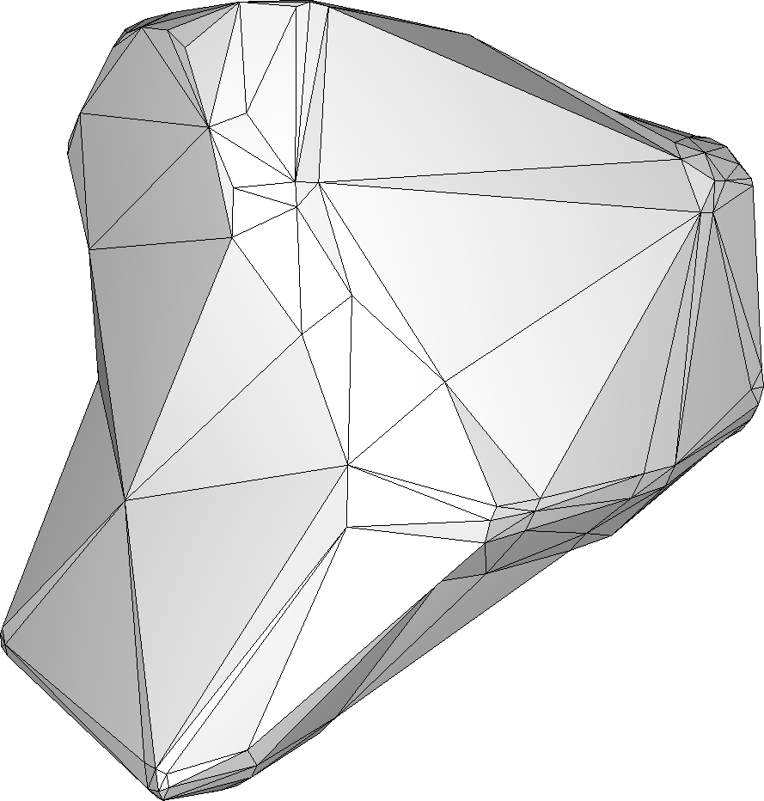
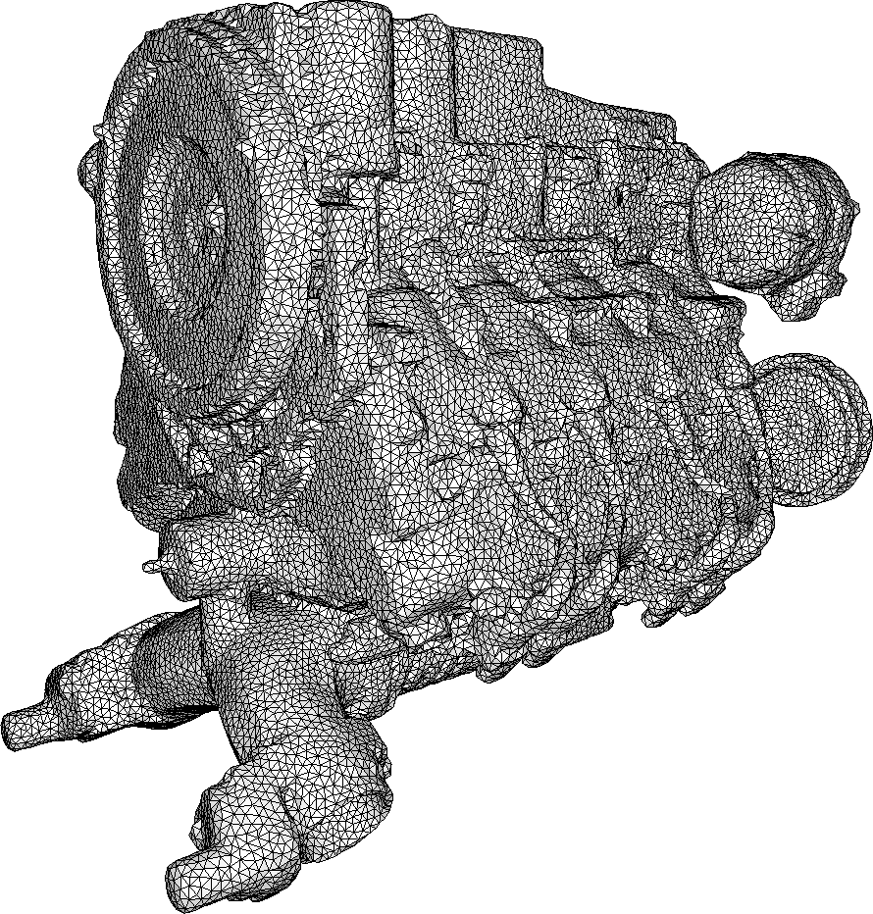
Problem statement
Input
3D model, possibly with defects
DESIRED Output
Watertight, manifold triangle mesh
No self-intersections
Enclosing the input
Unconditional robustness to input defects
Well-shaped (isotropic) triangles
Efficiency:
Ignore inner structures
Controllable complexity of output
Notes:
Voice (cont.): In particular, we wish to have a way to control the complexity of the output

Slide 7
Approach
Bridging the gap between
Alpha carving
and
shrink wrapping
Notes:
Voice: Our approach bridges the gap between a number of existing approaches by combining alpha shapes, mesh carving, and Delaunay-based meshing.

Slide 8
Meshing
Algorithm overview
Start from a bounding box
Alternate two atomic operations:
Carving: Get close to the input
Delaunay refinement: Add freedom to enable getting close to the input
Maintain a valid boundary at all times
Notes:
Voice: To create these points on the offset surface, we use an ambient 3D Delaunay triangulation and alternate carving and Delaunay refinement.

Slide 9
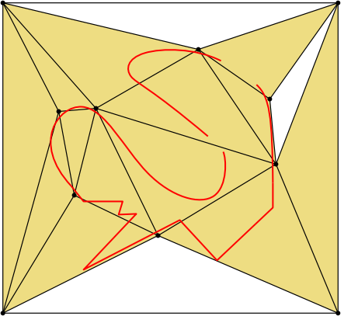
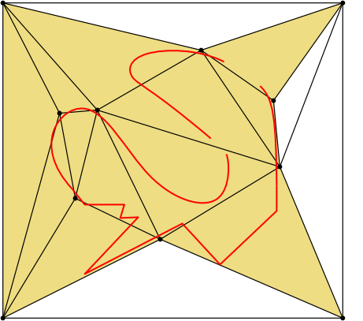
CARVING
Notes:
Voice: To create these points on the offset surface, we use an ambient 3D Delaunay triangulation and alternate carving and Delaunay refinement.

Slide 10
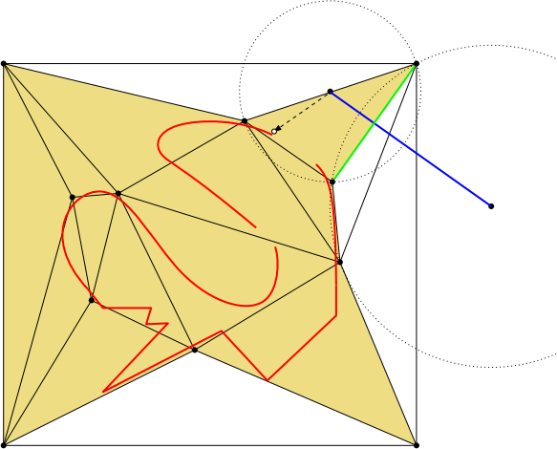
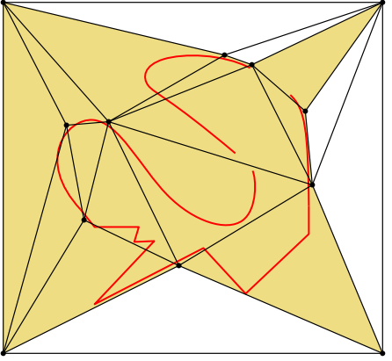
REFINEMENT
Notes:
Voice: To create these points on the offset surface, we use an ambient 3D Delaunay triangulation and alternate carving and Delaunay refinement.

Slide 11
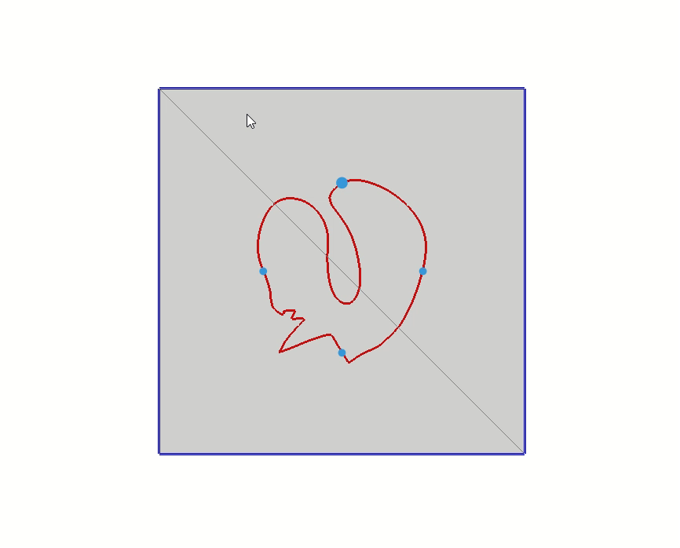
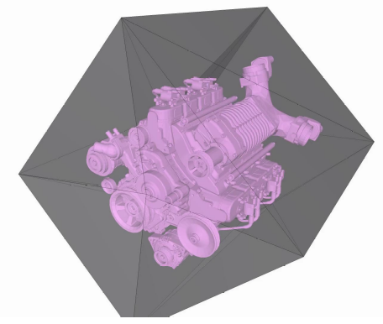
Algorithm illustration in 2D and 3D
Notes:
Voice: Here is an illustration of the algorithm on a simple 2D model

Slide 12
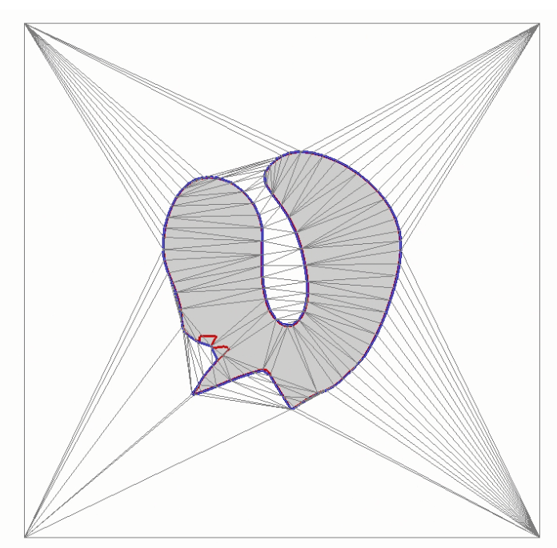
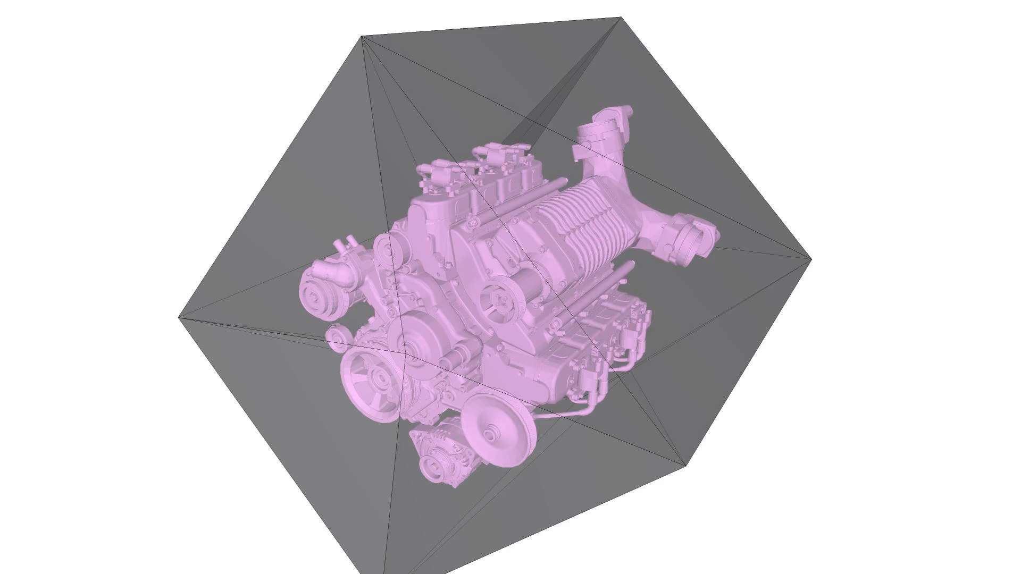
Algorithm illustration in 2D and 3D
Notes:
Voice: Here is an illustration of the algorithm on a simple 2D model

Slide 13
Results
Notes:
Voice: We now present some applications to illustrate the usefulness of our method.

Slide 14
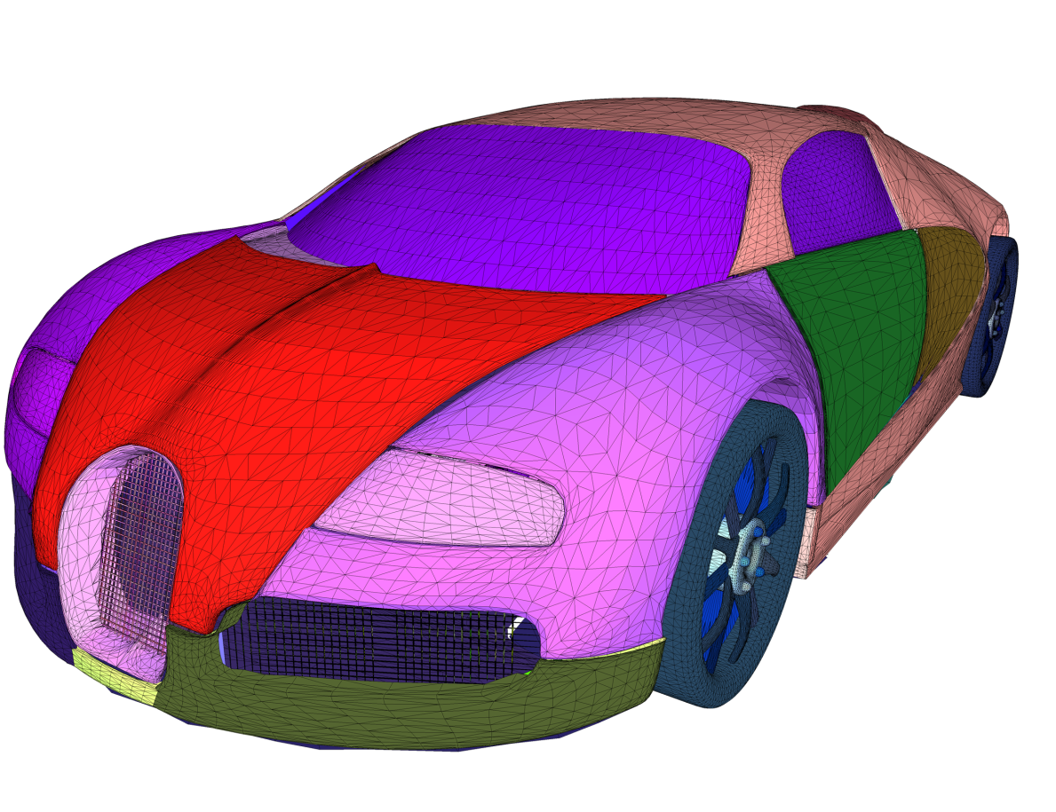
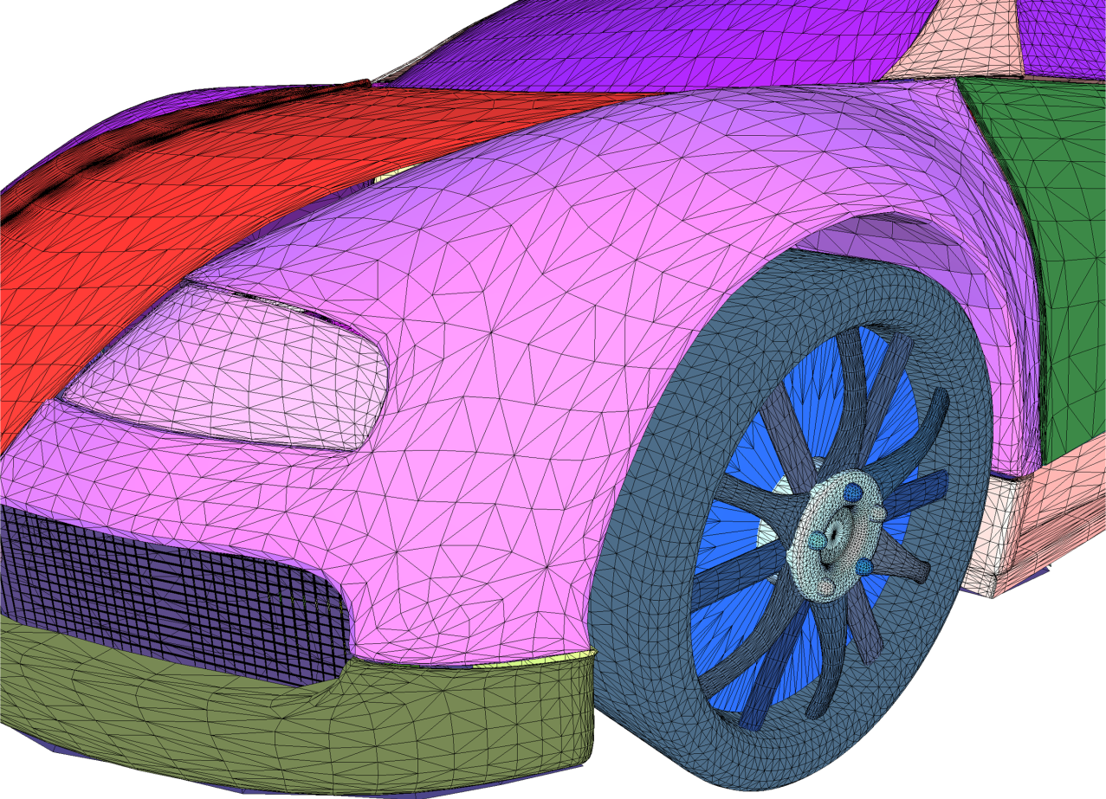
Application to FLOW SIMULATION
Bugatti model [Simscale], a defect-laden input
Multiple open connected components
Inner geometry
Degenerated elements
...
small holes
panel gaps & overlaps
Notes:
Voice: The following car model is riddled with all kinds of defect, making a flow simulation impossible. It also contains important inner geometry, which is irrelevant to the simulation.

Slide 15
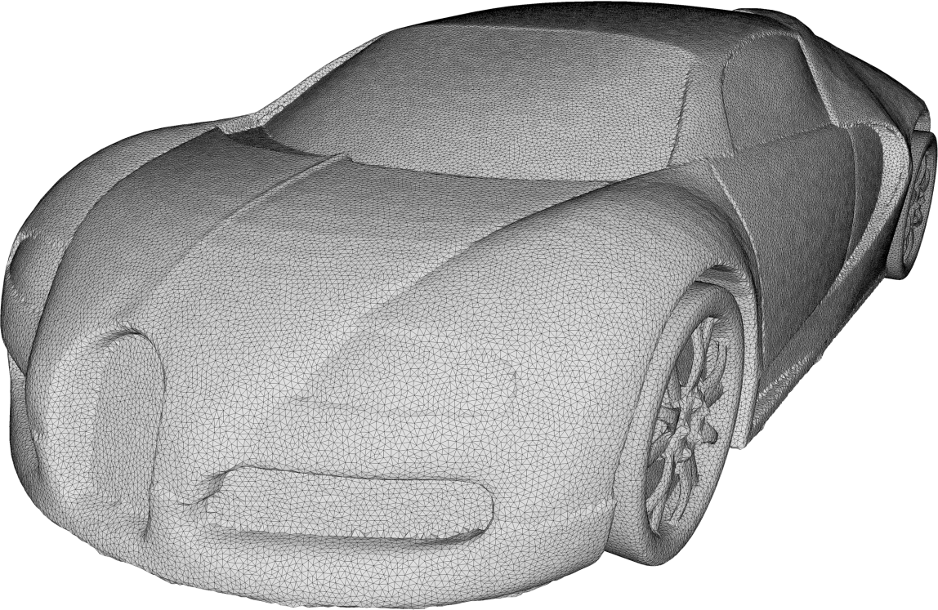
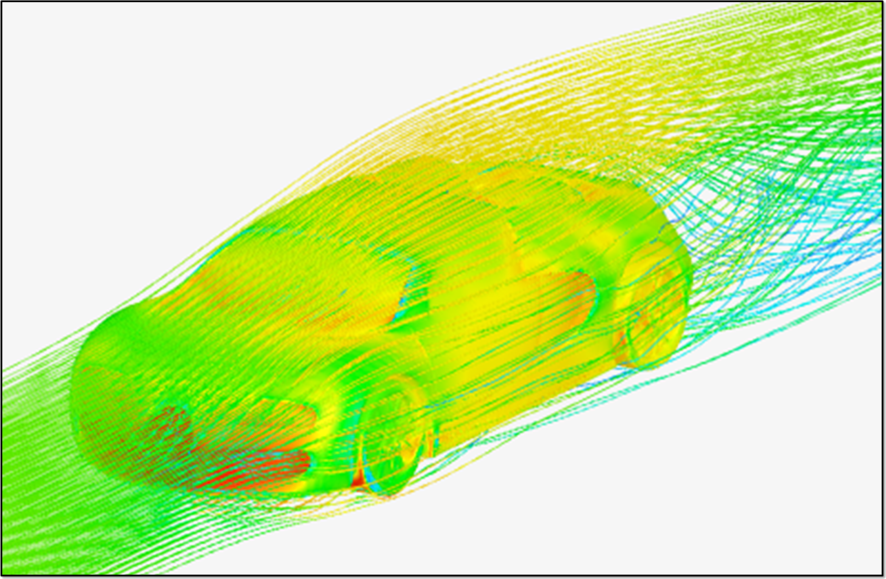
Application to flow simulation
Alpha Wrapping as input preprocessing for flow simulation
[Simscale]​
476k facets, 100s
Notes:
Voice: Our method produces a closed, manifold mesh on which simulations can be run successfully.

Slide 16
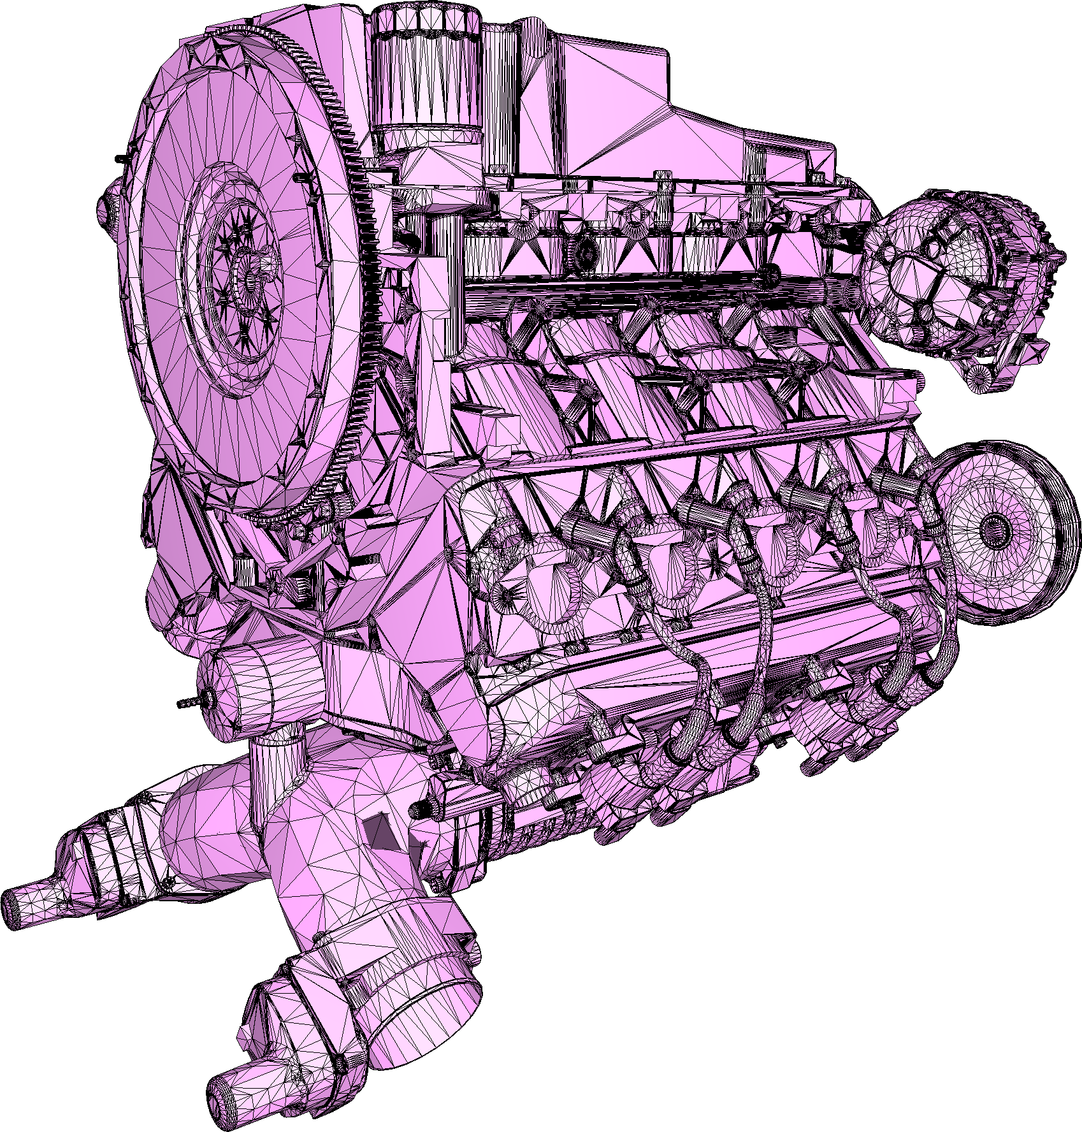
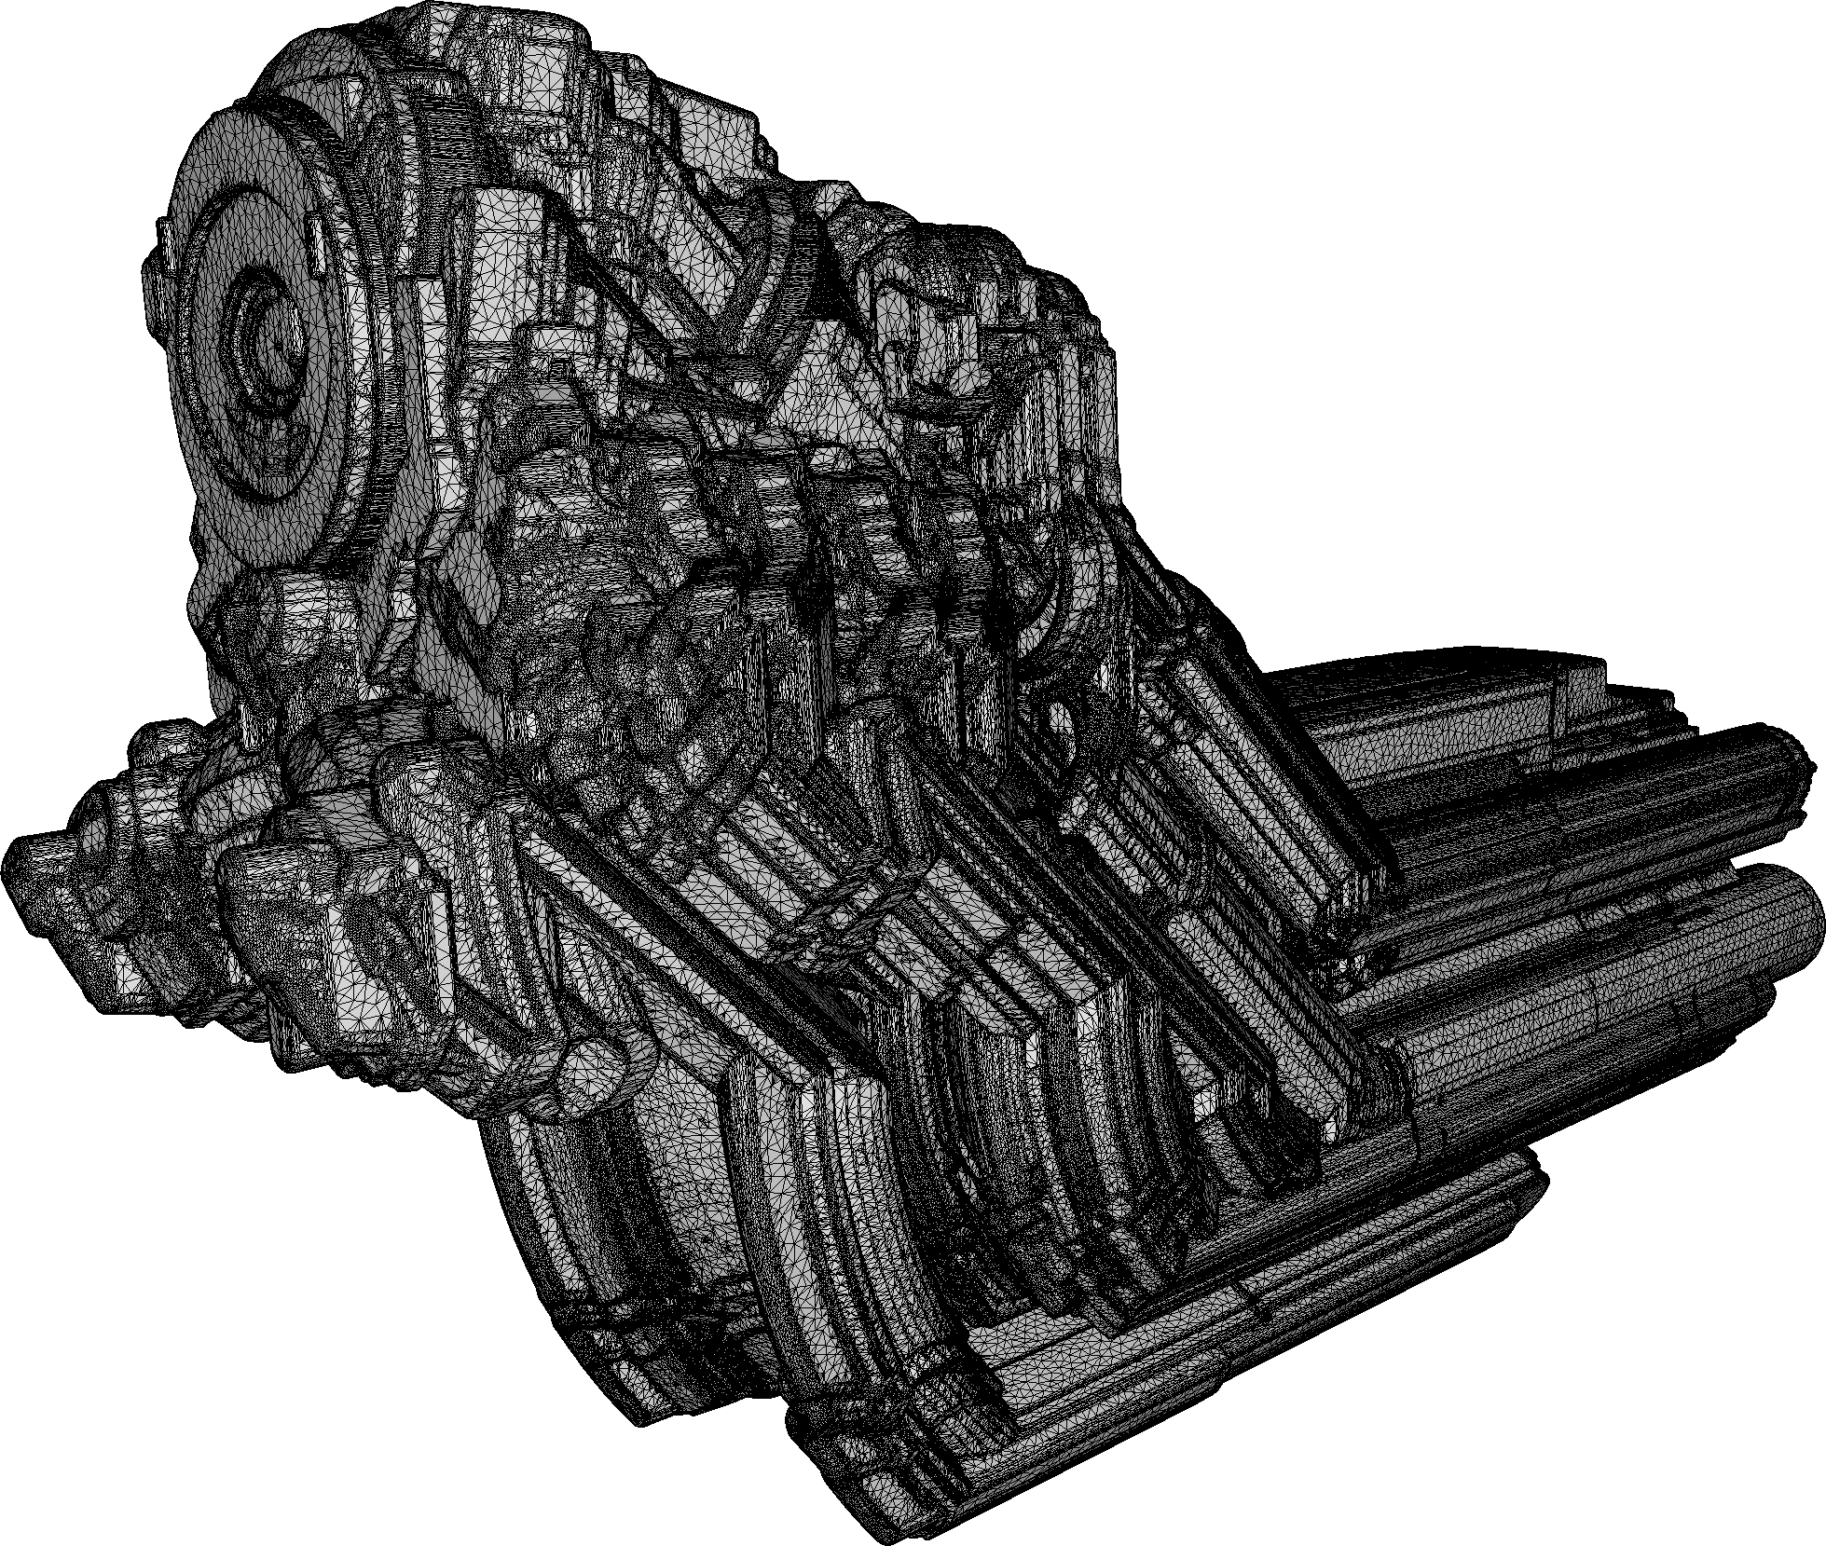
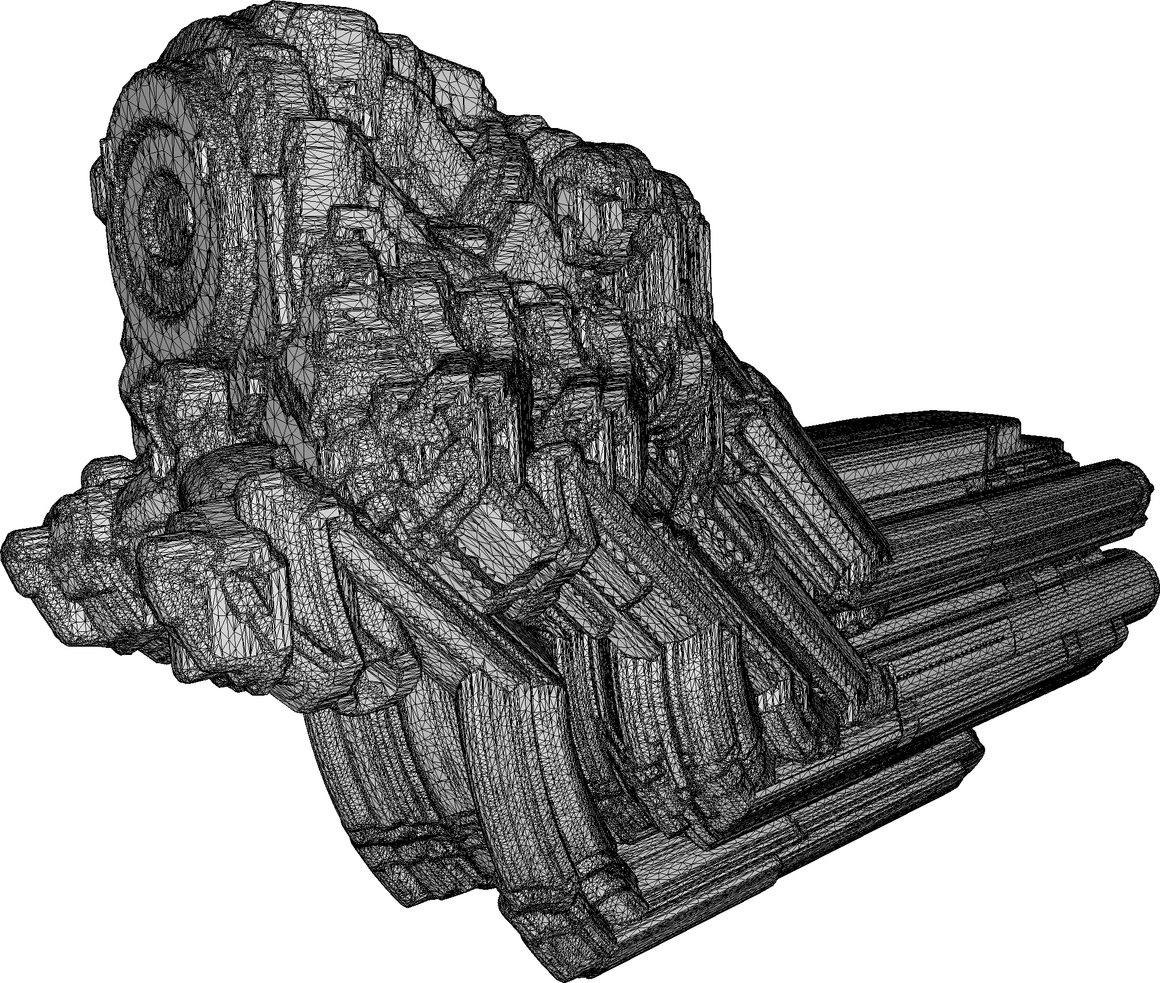
APplication to swepT volumes
Input:
Very large mesh
Complex inner structures
All kinds of defects
914s
1.7M facets
Output:
Lower mesh complexity
Valid mesh with no internal elements
Faster sweeping
Conservative and tight w.r.t. to exact sweep
242s
57k facets
Swept volumes by [RMAGS GmbH]
Notes:
Voice: Our method can also be used as a preprocessing step before sweeping, drastically reducing runtime.

Slide 17
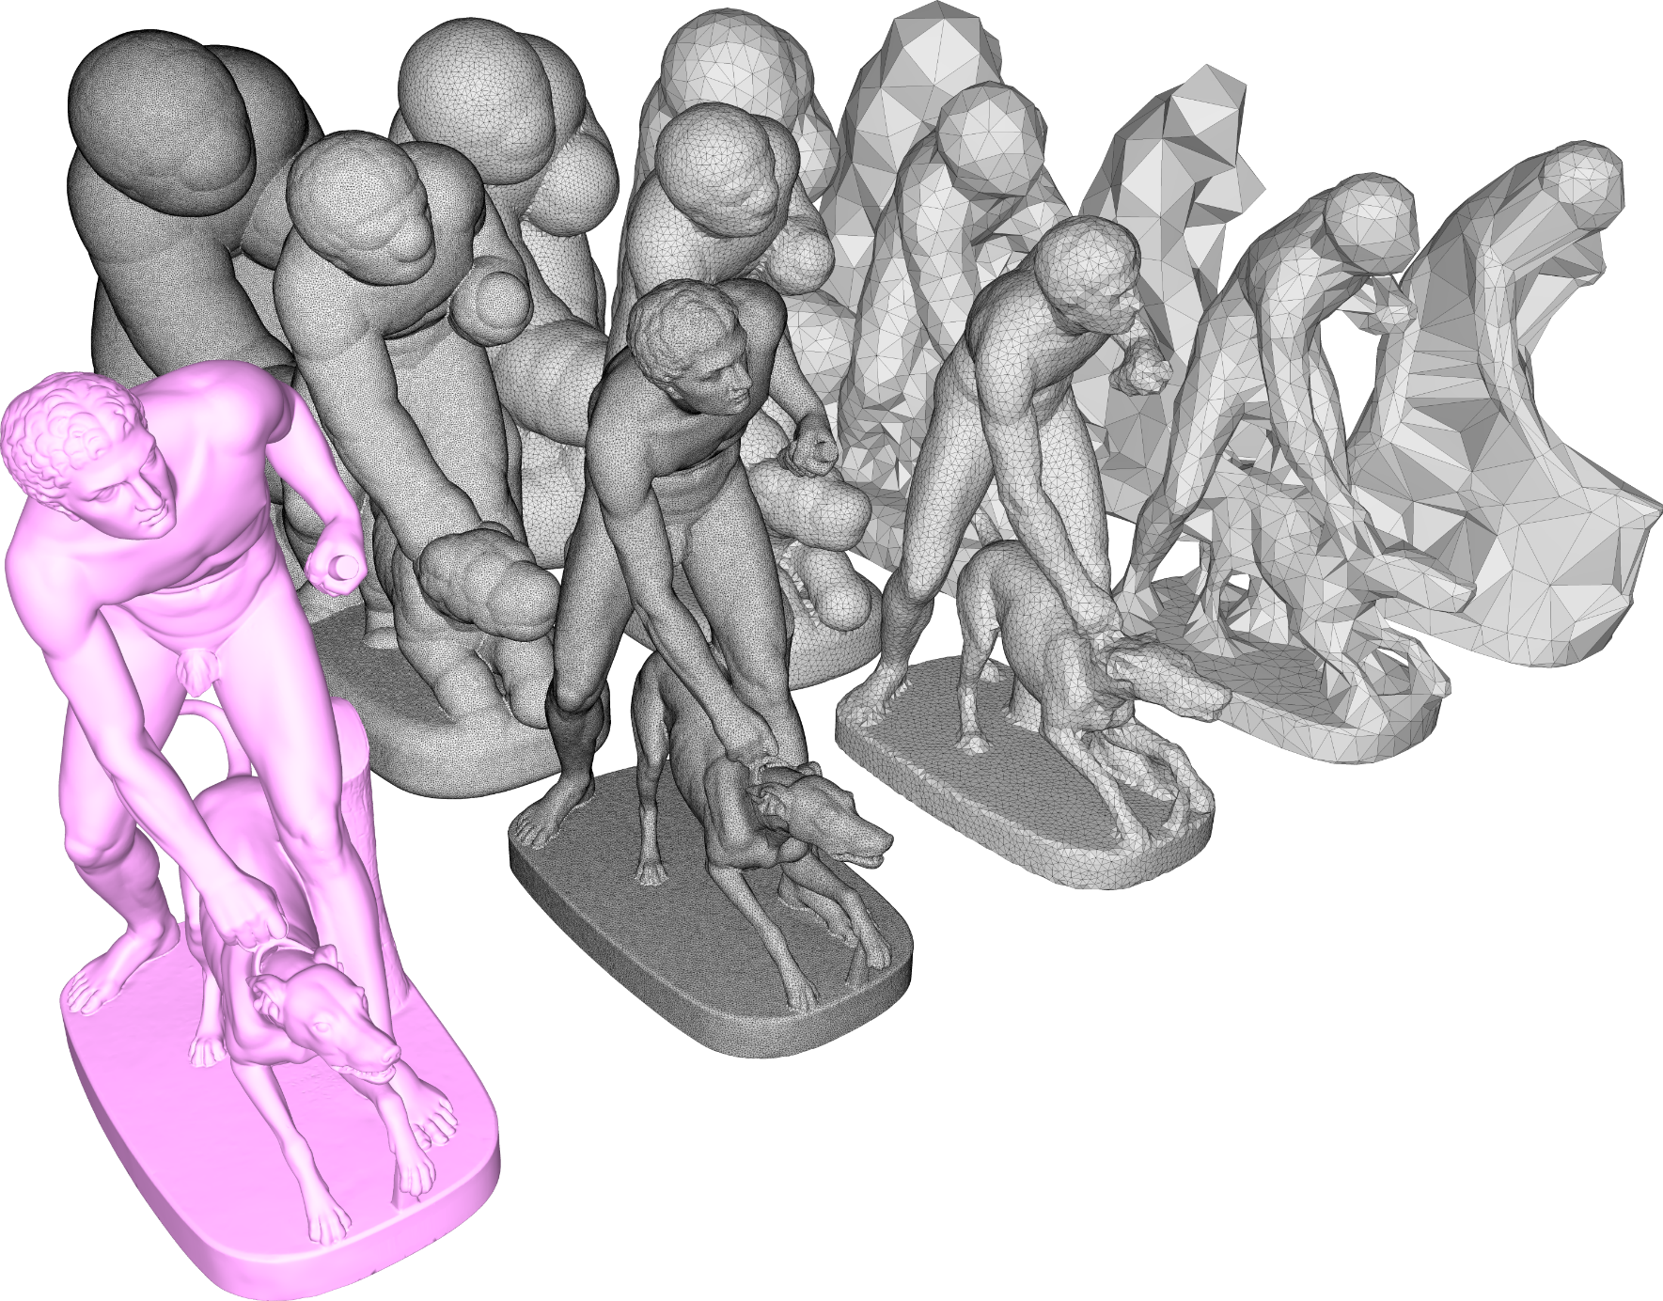
Algorithm parameters
Alpha
Controls the diameter of cavities to be explored
Acts as sizing field
Can be arbitrarily large or small
Offset
Guarantee closed 2-manifold mesh
Can also act as a defeaturing parameter, at the cost of tightness (similar to [Shewchuk 04])
Can be arbitrarily large or small
offset
alpha
input
Notes:
Voice: The behavior of the offset is similar to that of 𝛼 when it comes to features: small offset values ensure that the mesh is close to the input, and thus that it will capture well its geometry and features; on the other hand, large offset values act as a defeaturing tool.

Slide 18
Strengths
Notes:
Voice: We now expose the strengths of our method.

Slide 19
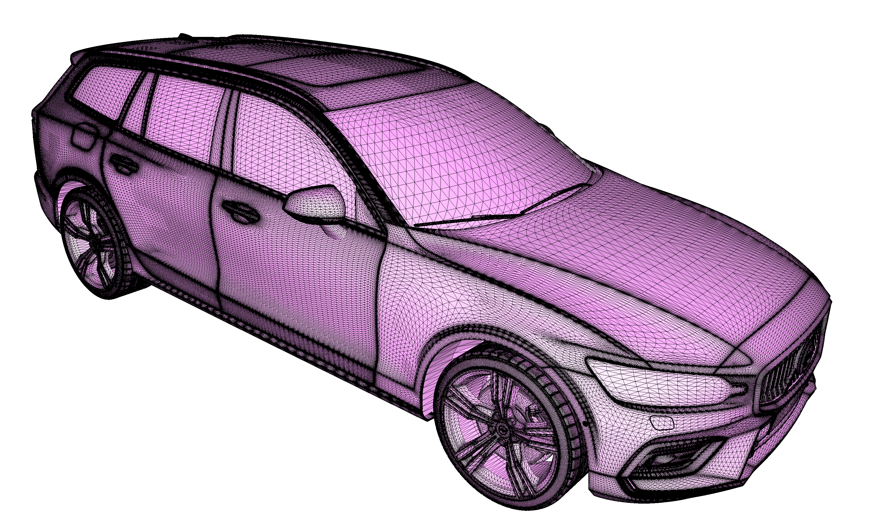
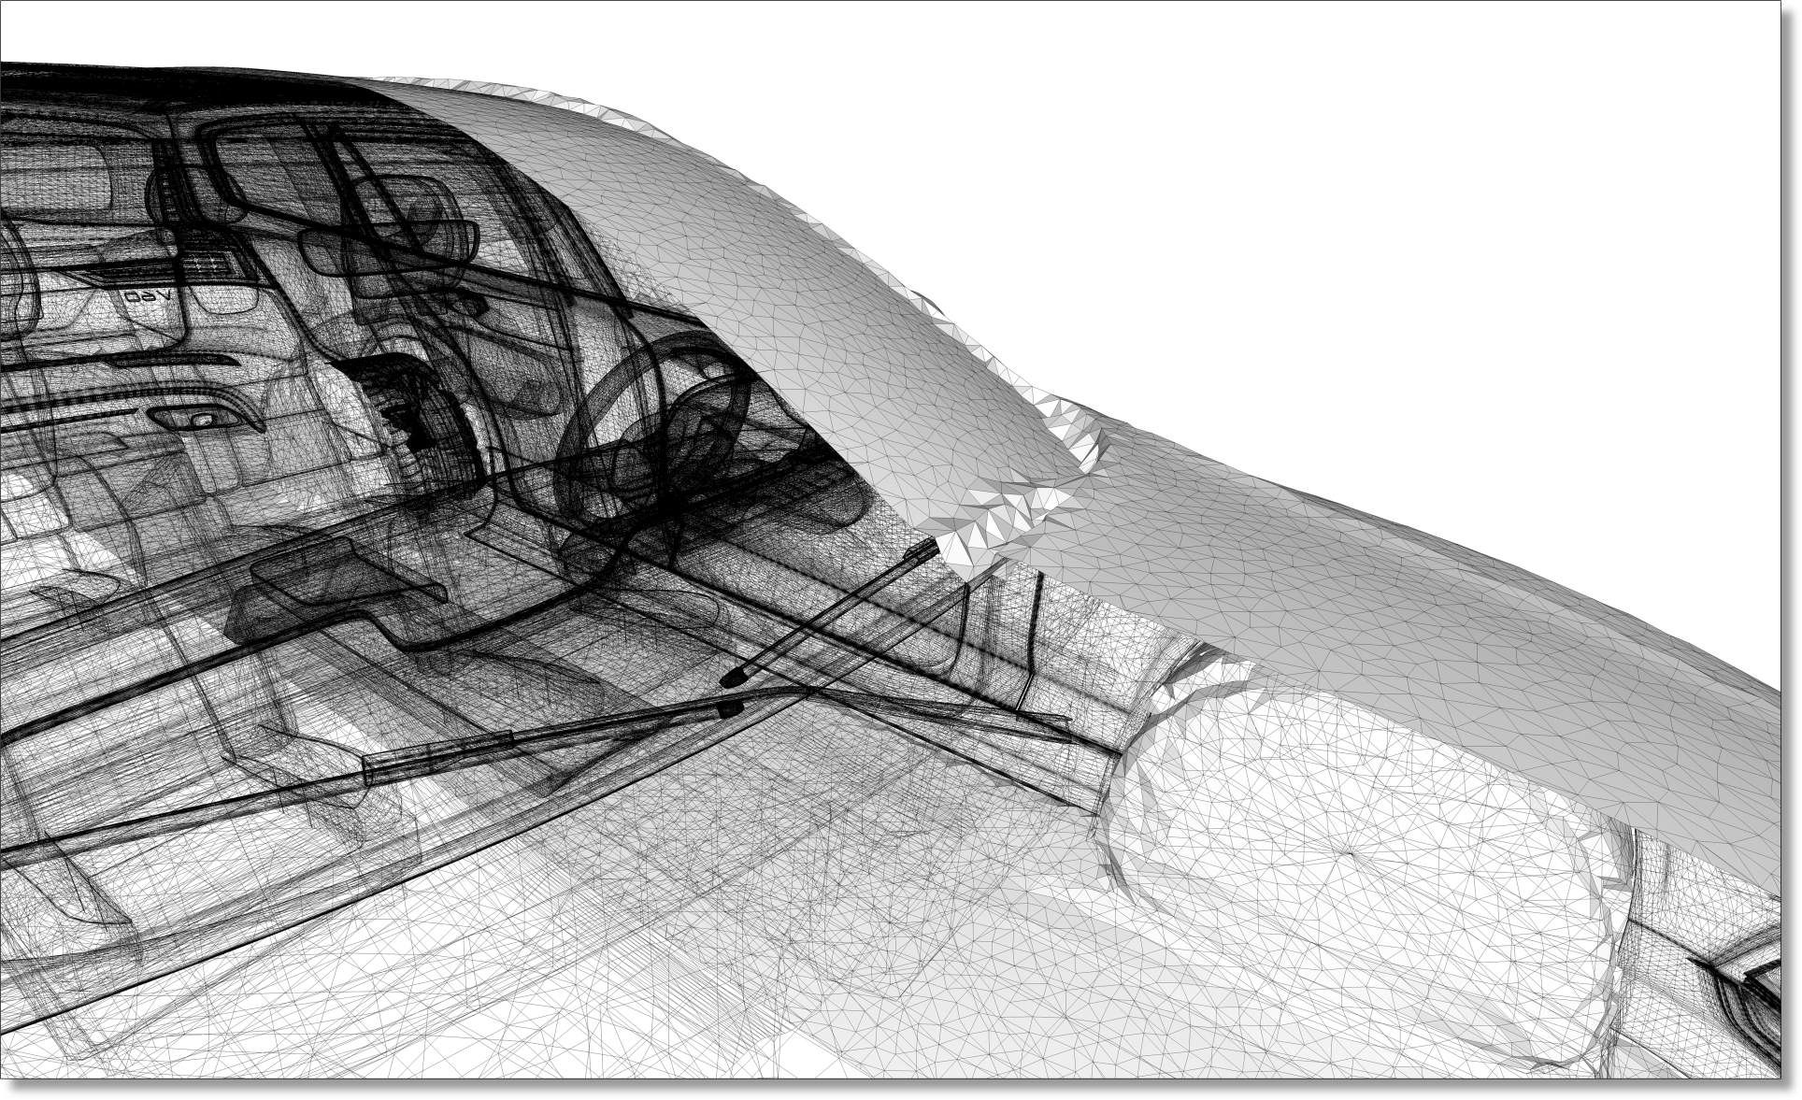
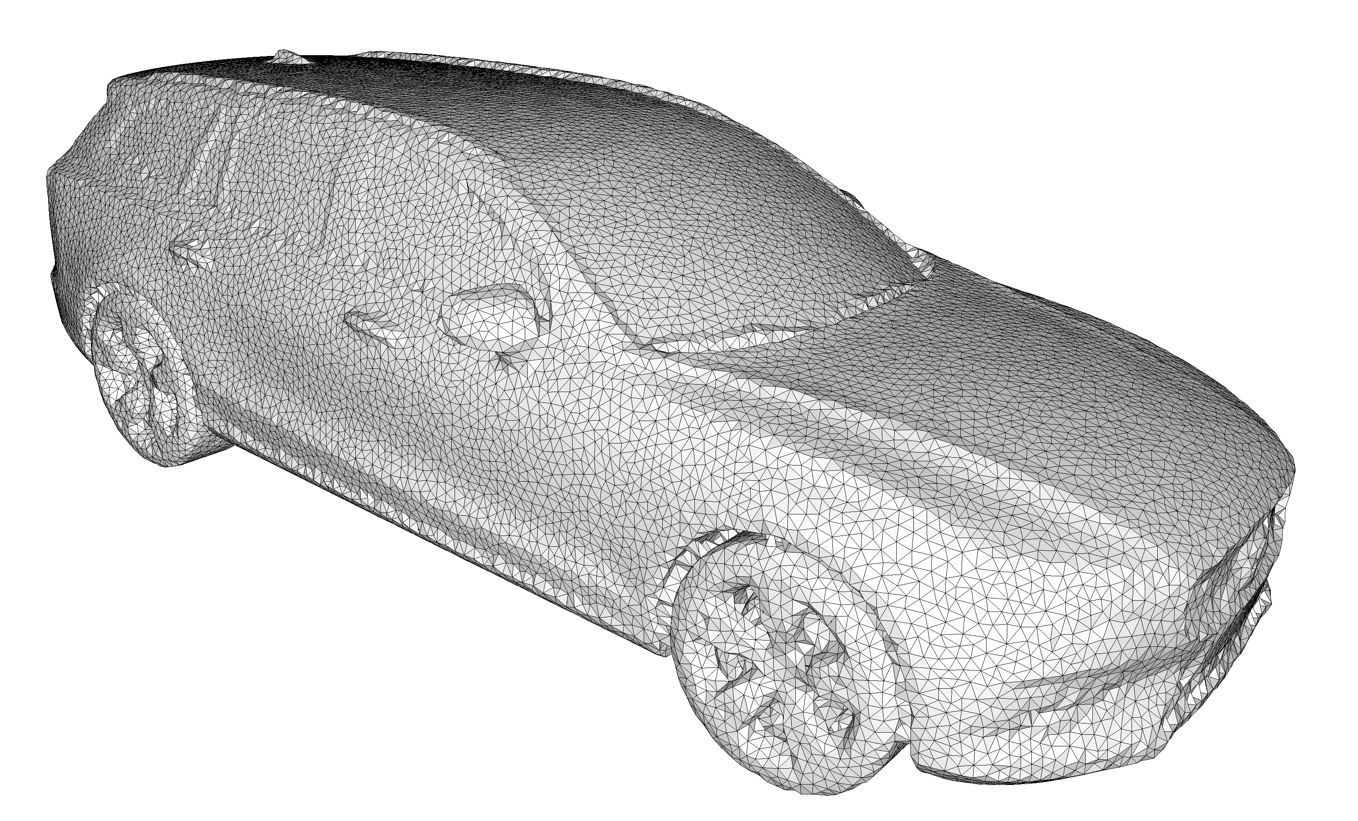
OUTPUT Sensitive COMPLEXITY
Notes:
Voice: The complexity of our algorithm depends primarily on the complexity of the output, meaning that complex inner structures have only a weak influence on the runtime, and no internal sampling is required.

Slide 20
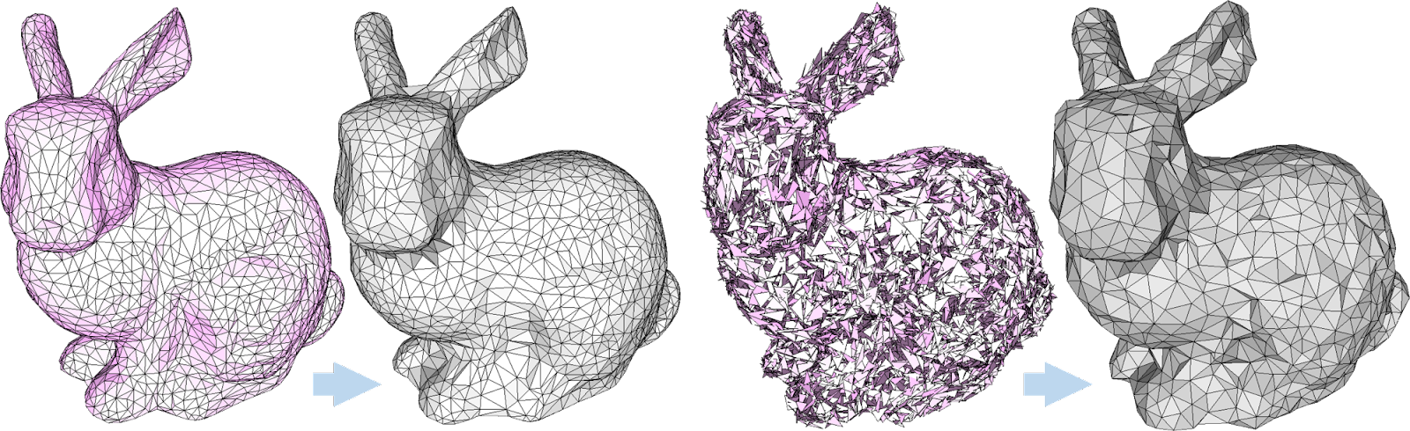
Robustness
Distance field-based approach: unconditional robustness to defects
Notes:
Voice: Thanks to its formulation making only use of an implicit distance function and basic intersection predicates, our algorithm is immune to the usual defects found in many meshes.

Slide 21
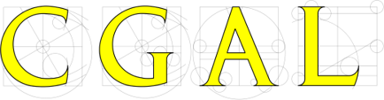
Correctness
Correctness: theoretical guarantees
Experimental Validation
Termination: using a 3D Delaunay triangulation enables use of the usual arguments (separation distance & packing argument)
No self-intersections, manifold: final surface mesh is extracted from a consistent underlying 3D triangulation
Closed, and enclosing the input: carving is disallowed if encroaching the input
Bounded one-sided Hausdorff distance (alpha + offset): faces of the output have a bounded Delaunay ball radius
Implementation: Code uses CGAL’s efficient exact predicates to ensure that theoretical guarantees are met.
Extensive assertions and tests: all checks are performed with exact computations, and the code is tested on large public datasets (Thingi10k, grabCAD, …)
https://www.cgal.org/
Notes:
Voice: Basing our algorithm on extensively studied data structures such as the Delaunay triangulation enabled us to guarantee in theory a number of important properties: termination, validity, input enclosing, and distance bounds.

Slide 22
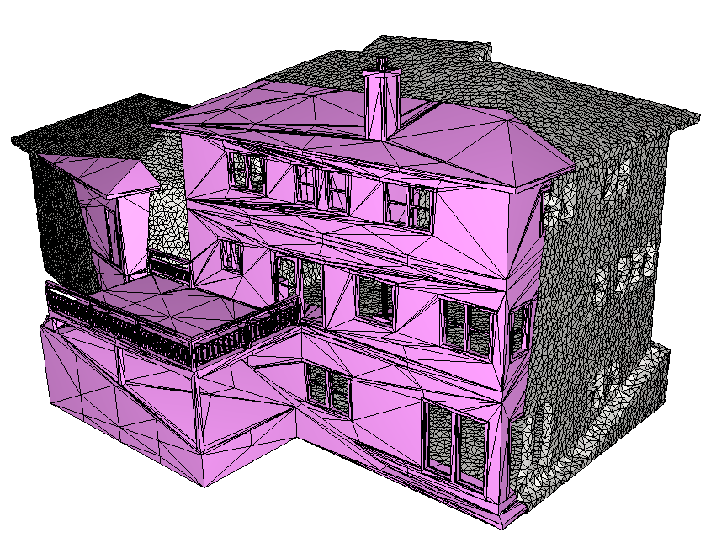
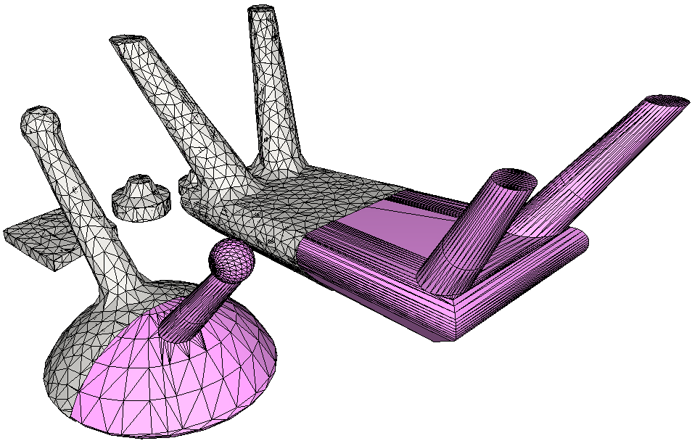
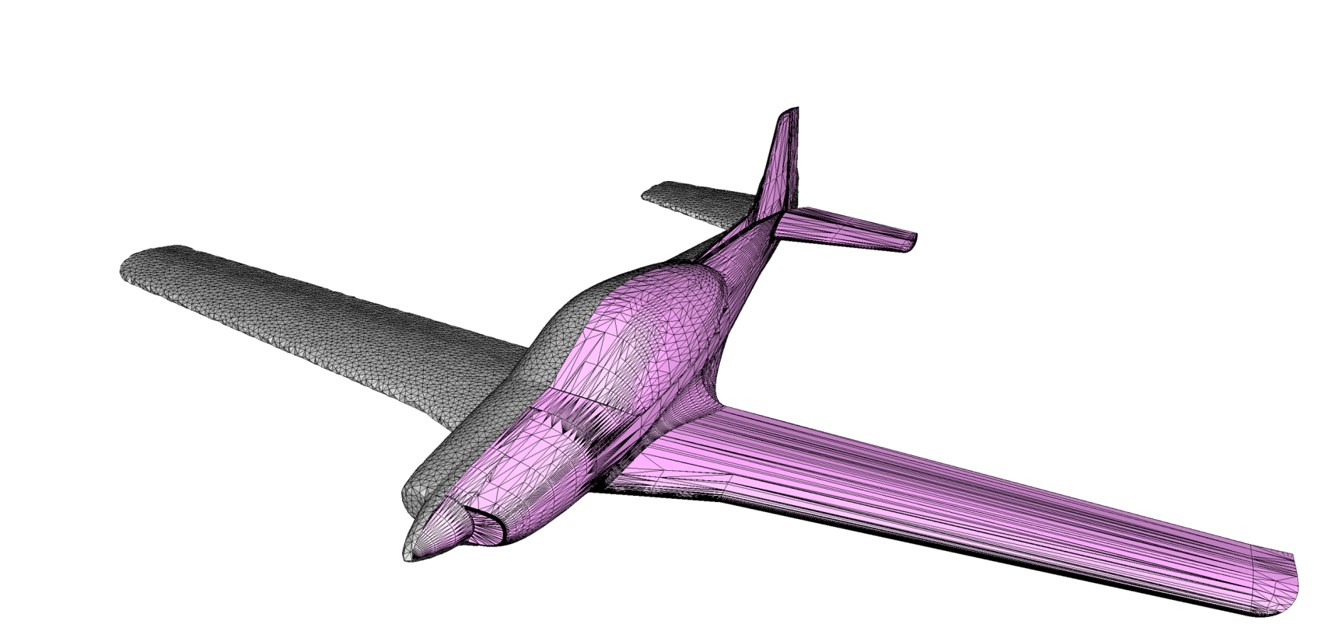
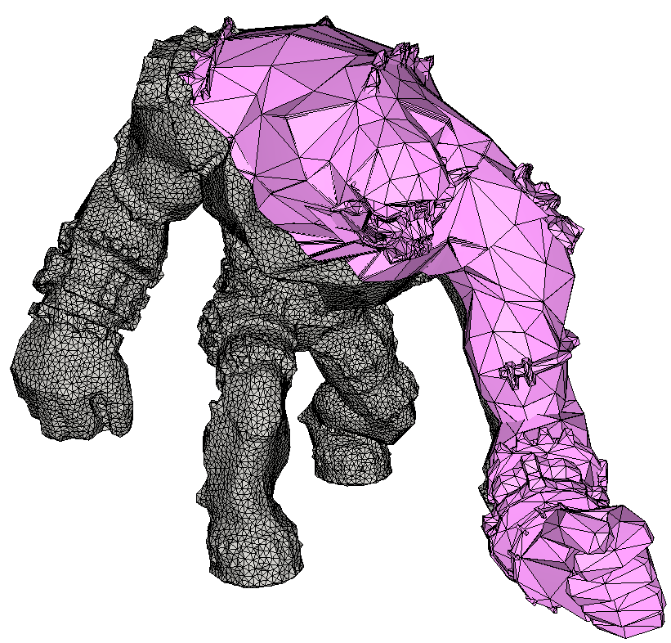
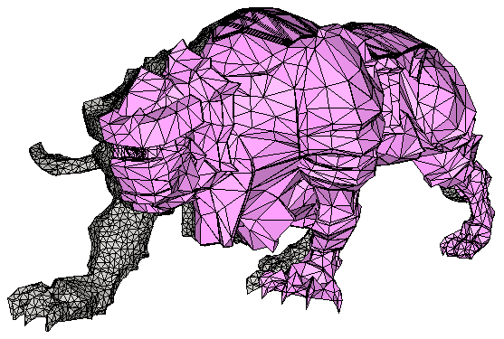
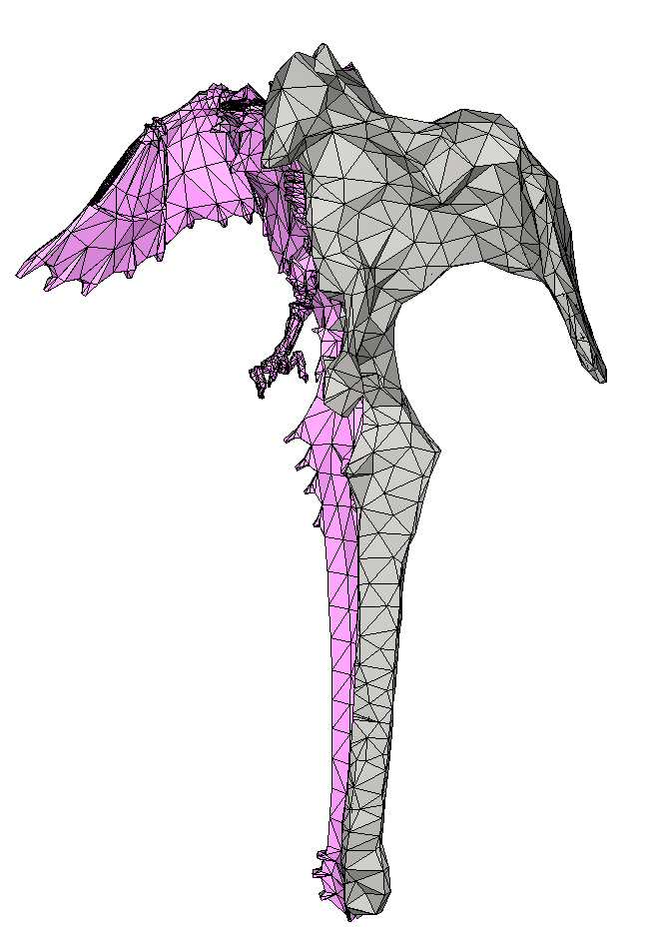
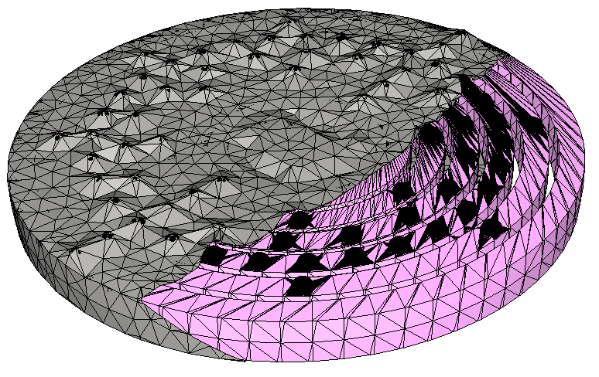
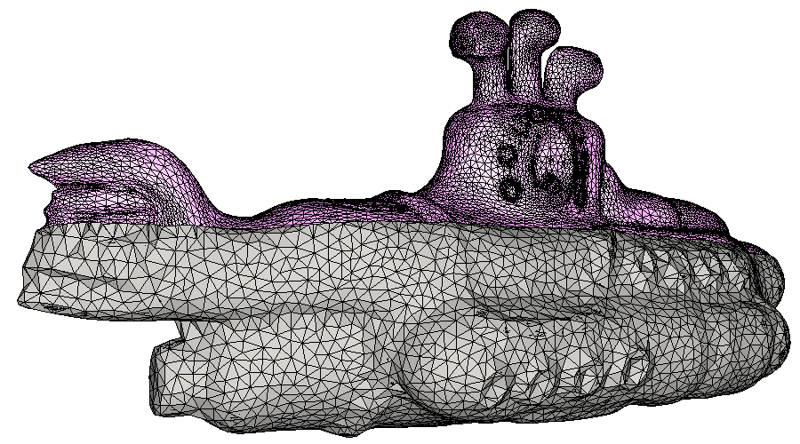
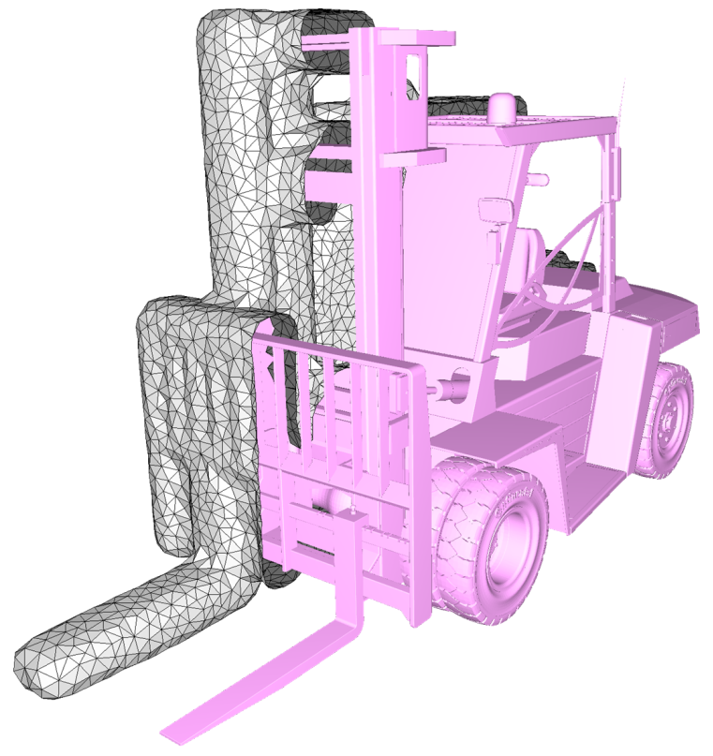
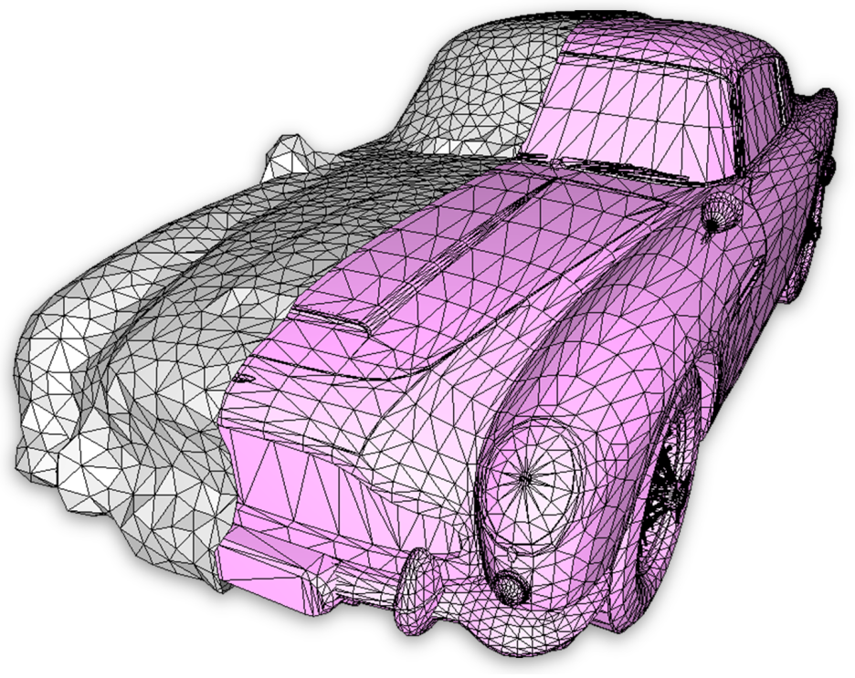
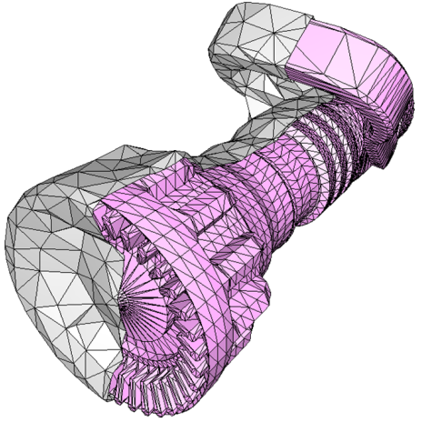
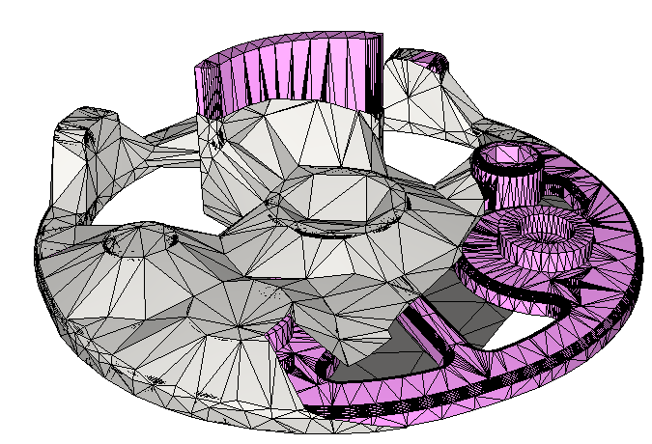
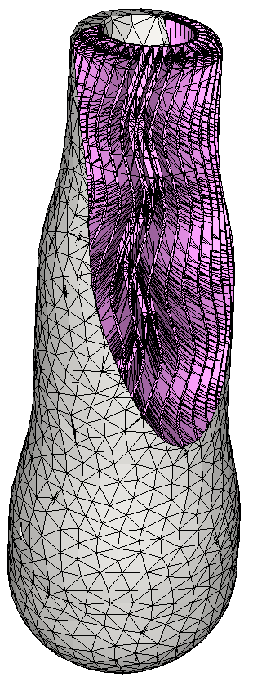




THANK YOU
LAB DEMO TOMORROW
Thursday, August 11
11:10 am
West Building, Ballroom A/B
Notes:
Voice: Thank you; code already available in CGAL. Join us at the SIGGRAPH Lab Demo in August for an extensive collaborative demo.

